Slide 1
Phonics Presentation
How many ways can you think of to spell the nonsense word:
Lightoe
For example:
Lightoh
Lightow
Liteoa

Slide 2
How many did you get?
Lightoe
Lightoh Lytoh Lyto
Lightow Lytow Lieto
Liteoa Lytoa
Lightoa Lietow
Liteoh Lietoh
Liteow Lietoa
Liteoa Lighto
The English language and spelling system is a very tricky business! Thankfully teaching the children a progressive phonics scheme helps ease this…

Slide 3
Phonics in Year 1
Phonics is taught daily to all children in EYFS and Key Stage 1.
Children begin by learning phonemes (the sounds the letters make), before moving on to digraphs (sounds made using 2 letters) and trigraphs (sounds made using 3 letters).
Blending is the process that is involved in bringing the sounds together to make a word or a syllable and is how /c/ /a/ /t/ becomes cat.

Slide 4
How does my child learn phonics?
Phonics is split into stages. Children may learn pre phonics skills in nursery that are focused on listening and rhyming skills, before moving onto phases in Reception. By the end of Year R they will have been taught many digraphs and some initial/final blends.
There is a big focus on segmenting (breaking the words down into sounds, usually to aid spelling) and blending (blending the sounds into whole words when reading), and children are encouraged to use these skills as they learn the sounds within their stage.
In Year 1 the children will learn alternative graphemes, for example they may learn oa in Year R and in Year 1 they will learn the ow grapheme.

Slide 5
How does my child learn phonics?
In Year 2 the children will learn more spelling rules and will be able to apply the graphemes they have been taught to spell more unfamiliar words.

Slide 6
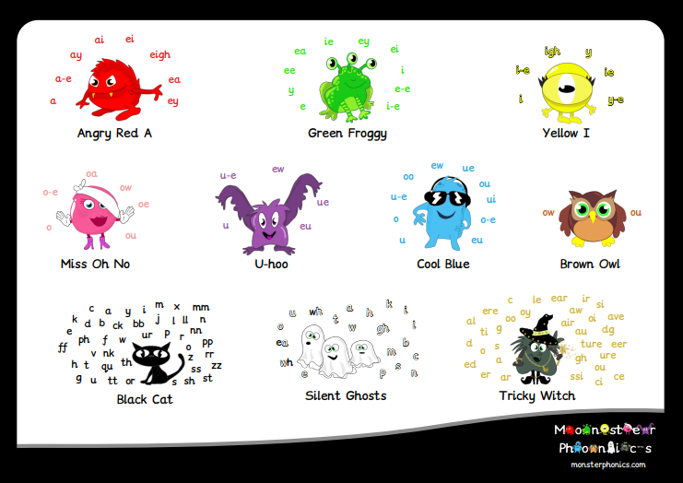

Slide 7
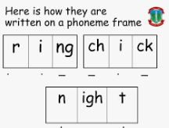
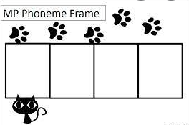
Strategies
To ensure that children are really looking at the sounds within a word, we use a variety of strategies.
Robot Arms
This is where we move our arms like a robot or Ninja when saying all the sounds we can read in a word. When we have read all the sounds we blend them together again.
Dotting and Dashing or Beans and Sausages
The children might know this as drawing ‘beans
and sausages’ under their words to indicate
phonemes and digraphs/trigraphs. E.g
Colour Coding
Our phonics scheme, Monster Phonics, uses colour coding to enable children to identify and read words that may otherwise be unfamiliar by using the clever colour code monsters that they all know and love.
bee
hide
Phoneme Frames
We use these to help hear and spell the
sounds in words. Sometimes a box on a phoneme
Frame holds a single phoneme, or a digraph/trigraph.

Slide 8
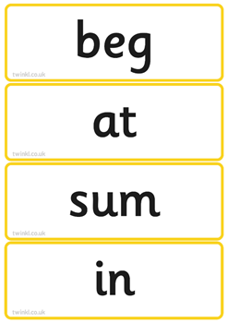
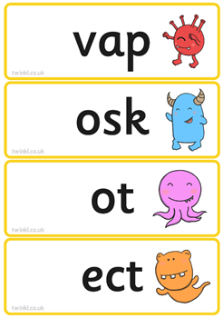
Real Words & Alien Words
We also use a mixture of real words and alien words, in order to encourage children to really look at the sounds within the words. This also prepares them for their phonics screening check in Year 1 (PSC).

Slide 9
Phonics Screening Check
All Year 1 children throughout the country take part in a phonics screening check during the summer term. This year they are commencing on the week of the 10th June.
It is designed to confirm whether individual children have learnt sufficient blending and decoding skills to read to an appropriate standard.

Slide 10
Phonics Screening Check
Completed on a 1:1 basis by a teacher.
Usually takes 5-10 minutes, but there is no time limit.
Check is 40 words long, 20 pseudo (fake words), 20 real.
Pseudo/Fake/Nonsense/Alien words are presented with a picture of an alien, so the children think this is the alien’s name
Pseudo words are used to help the teacher to be sure that the child is able to decode words not just read them from memory. Then in the future they will be able to decode longer, and more unusual vocabulary.

Slide 12
The expected pass mark has been 32/40 in the past, however the DfE does not release the pass mark until a week after the children have completed the tests.
It is expected that all children complete the test, unless they have no understanding of phoneme-grapheme correspondence.
If a child does not meet the expected standard, then in Year 2 extra support and provision will be put in place for them. They will then complete the check again in Year 2 the following June.
You will be informed of your child’s result on their school report. The data gathered will be used within school to help provide assessment and inform planning for us as teachers.
Data is also sent to the DfE where it collates information about the standard of phonics across the whole country.

Slide 13
How to help at home…
www.teachyourmonstertoread.com
On the website or as an app on your tablet or smart phone, this is a fantastic game for all different levels and abilities.
www.phonicsplay.com
Try free games Picnic on Pluto and Buried Treasure – Phase 3,4,5
www.phonicsbloom.com
Try the Yeti game in Phase 3,4,5

Slide 14
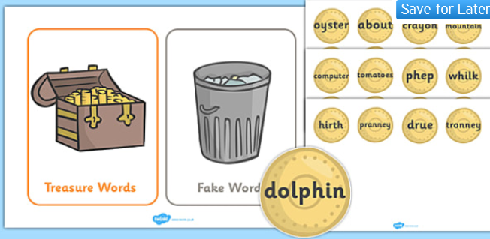
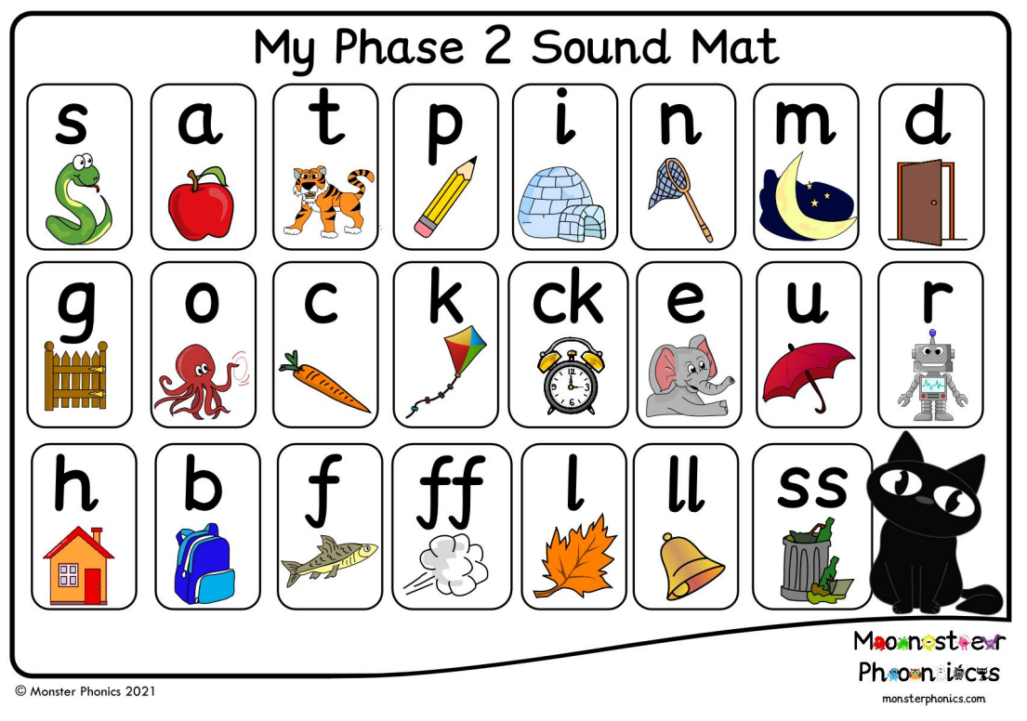
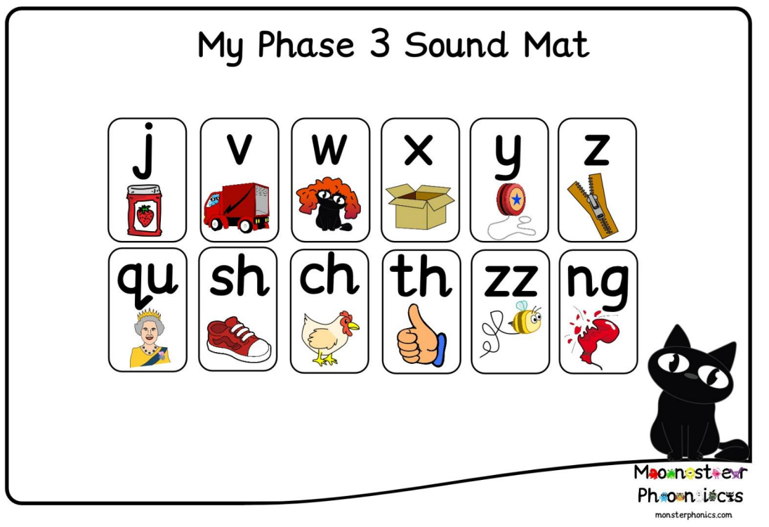
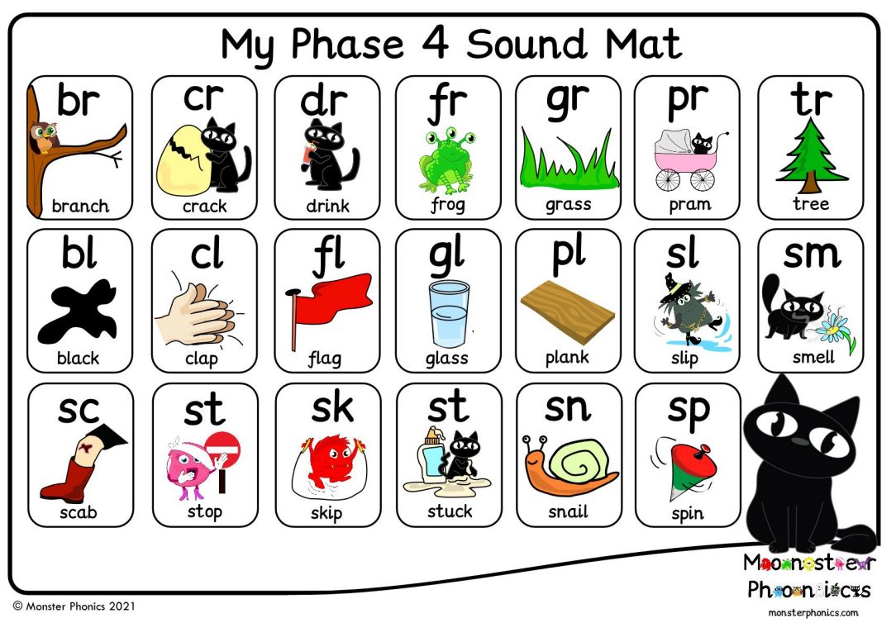
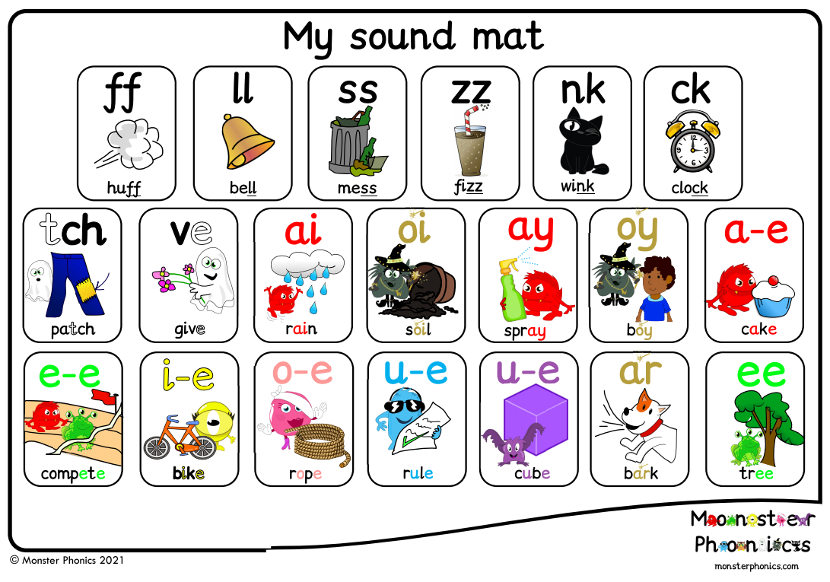
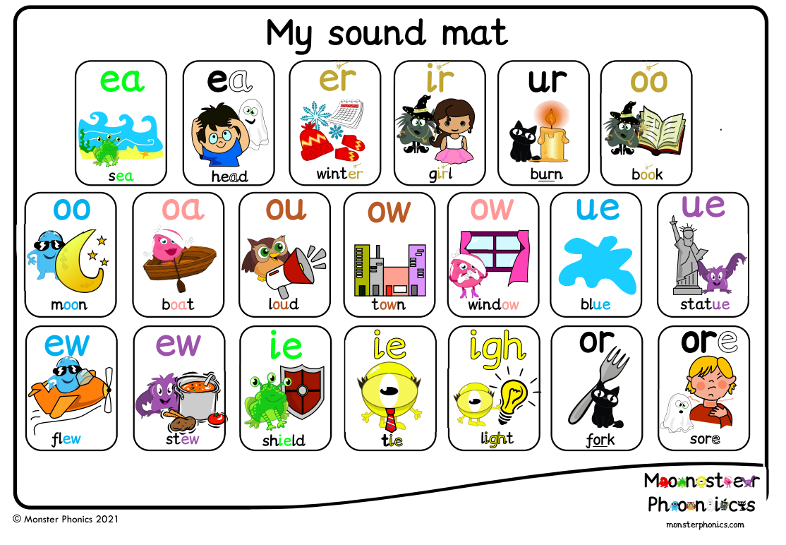
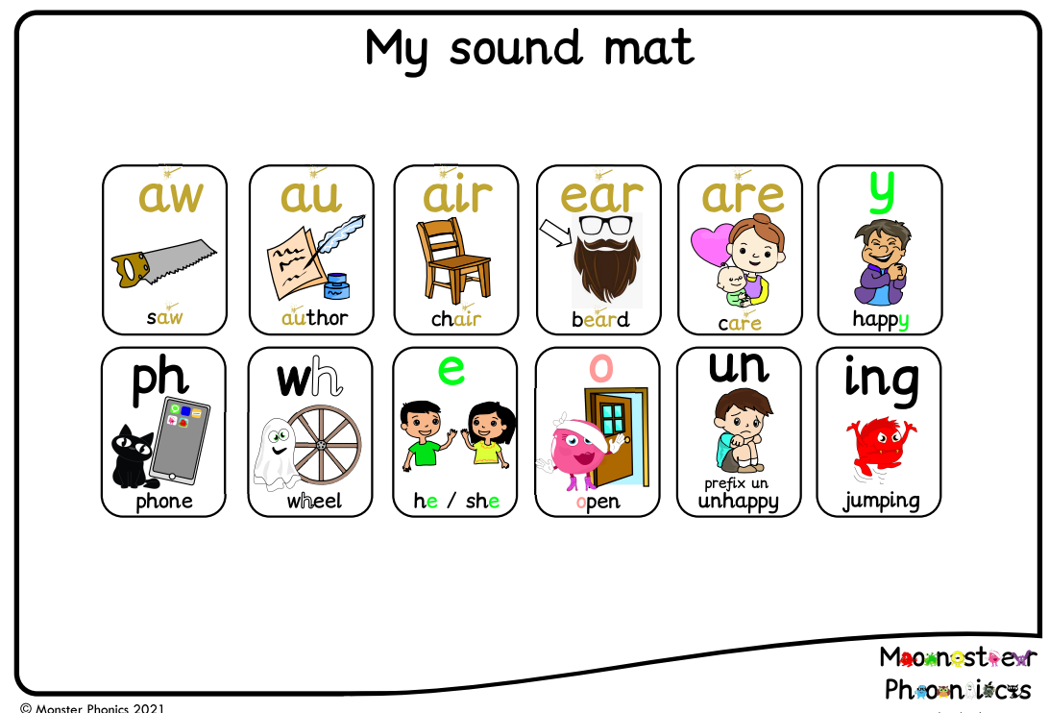
How to help at home…
www.twinkl.co.uk
If you create an account there are some free resources you can access for phonics.
Read every day!
Reading everyday will improve your child’s reading. Read 3 times a week minimum.
Have phonics up and around at home; these sound mats are available for you today.

Slide 15
Thank you for coming…
You will receive a handout with information regarding how to help at home with useful links, some practise alien words, sound mats for all relevant stages
This handout will be placed in your child’s bookbag by the end of this week.
We will be sending out regular phonic words to use at home.
If you have any questions please do stay at the end and ask them.

