Slide 1
Welcome!
While you wait…
How many ways can you think of to spell the nonsense word:
Lightoe
For example:
Lightoh
Lightow
Liteoa

Slide 2
How many did you get?
Lightoe
Lightoh Lytoh Lyto
Lightow Lytow Lieto
Liteoa Lytoa
Lightoa Lietow
Liteoh Lietoh
Liteow Lietoa
Liteoa Lighto

Slide 3
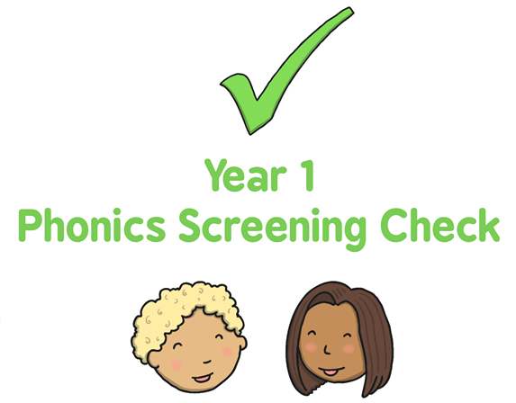

Slide 4
Year 1
Phonics is taught daily to all children in EYFS and Key Stage 1.
Children begin by learning phonemes (the sounds the letters make), before moving on to digraphs (sounds made using 2 letters) and trigraphs (sounds made using 3 letters).
Blending is the process that is involved in bringing the sounds together to make a word or a syllable and is how /c/ /a/ /t/ becomes cat.

Slide 5
How does my child learn phonics?
The phonics are split into phases. Children tend to learn phase 1 in Nursery, before moving onto phases 2, 3 and some of phase 4 in reception, then the end of phase 4 and phase 5 in Year 1.
There is a big focus on segmenting (breaking the words down into sounds) and blending (blending the sounds into whole words), and children are encouraged to use these skills as they learn the sounds within their phase.

Slide 6
How does my child learn phonics?
To ensure that children are really looking at the sounds within a word, we use a variety of strategies.
Robot Arms/Ninja Arms
Snowball Sounds
Dotting and Dashing
Phoneme Frames
and lots of repetition!

Slide 7
Real Words & Alien Words
We also use a mixture of real words and alien words, in order to encourage children to really look at the sounds within the words.

Slide 8
Phonics Screening Check
All Year 1 children throughout the country take part in a phonics screening check during the summer term.
It is designed to confirm whether individual children have learnt sufficient blending and decoding skills to read to an appropriate standard.

Slide 9
Phonics Screening Check
Completed on a 1:1 basis by a teacher.
Usually takes 5-10 minutes, but there is no time limit.
Check is 40 words long, 20 pseudo 20 real.
Pseudo words are presented with a picture of an alien, so the children think this is the alien’s name
Pseudo words are used to help the teacher to be sure that the child is able to decode words not just read them from memory. Then in the future they will be able to decode longer, and more unusual vocabulary.

Slide 11
The expected pass mark has been 32/40 in the past, however the DfE does not release the pass mark until a week after the children have completed the tests.
It is expected that all children complete the test, unless they have no understanding of phoneme-grapheme correspondence.
If a child does not meet the expected standard, then in Year 2 extra support and provision will be put in place for them. They will then complete the check again in Year 2 the following June.
You will be informed of your child’s result via a letter. The data gathered will be used within school to help provide assessment and inform planning for us as teachers.
Data is also sent to the DfE where it collates information about the standard of phonics across the whole country.

Slide 12
How to help at home…
www.teachyourmonstertoread.com
On the website or as an app on your tablet or smart phone, this is a fantastic game for all different levels and abilities.
www.phonicsplay.com
Try free games Picnic on Pluto and Buried Treasure – Phase 3,4,5
www.phonicsbloom.com
Try the Yeti game in Phase 3,4,5

Slide 13
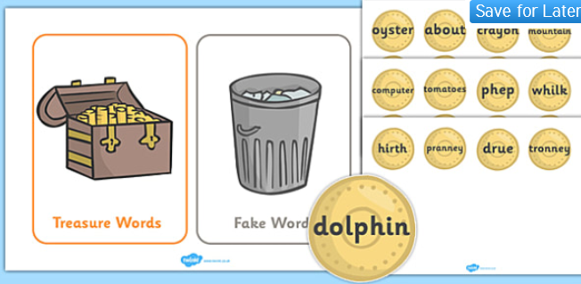
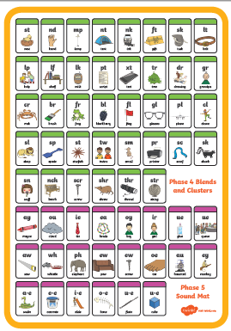
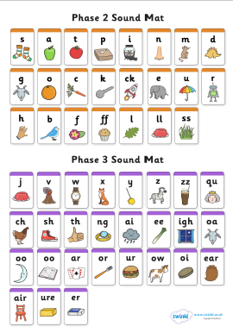
How to help at home…
www.twinkl.co.uk
If you create an account there are some free resources you can access for phonics.
Read every day!
Reading everyday will improve your child’s reading. Read 3 times a week minimum.
Have phonics up and around at home; these sound mats are available for you today.

Slide 14
Let’s Meet the Experts
The children will now have the chance to show you some of the games we play in our phonics sessions and resources we have in school.

